Slide 1
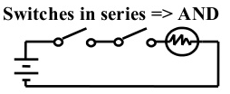

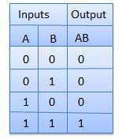
Logic Gates
AND Gate
Logic diagram
Logic equation Y = A . B
Truth Table

Slide 2
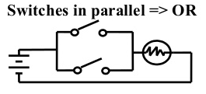

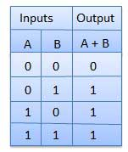
OR Gate
Logic diagram
Logic equation Y = A + B
Truth Table

Slide 3
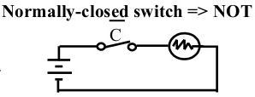

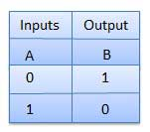
NOT Gate
Logic diagram
Logic equation Y = A
Truth Table

Slide 4
Boolean Algebra
Boolean Algebra is used to analyze and simplify the digital (logic) circuits. It uses only the binary numbers i.e. 0 and 1.
Commutative law
Associative law
Distributive law

Slide 5


Boolean Laws
AND law
OR law
INVERSION law

Slide 6

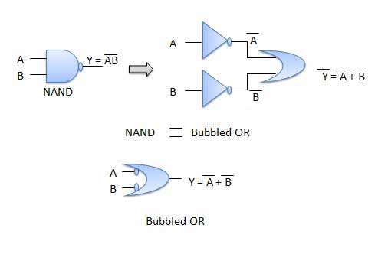
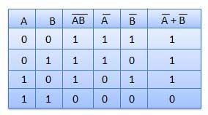
De Morgan's Theorems
Theorem 1

Slide 7

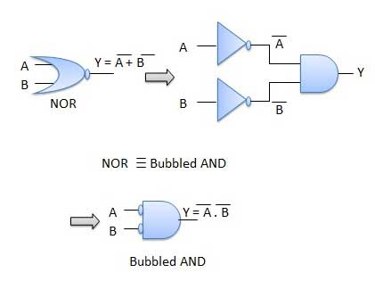
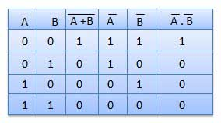
De Morgan's Theorems
Theorem 2

Slide 8
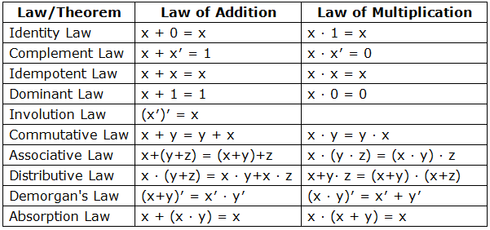

Slide 9
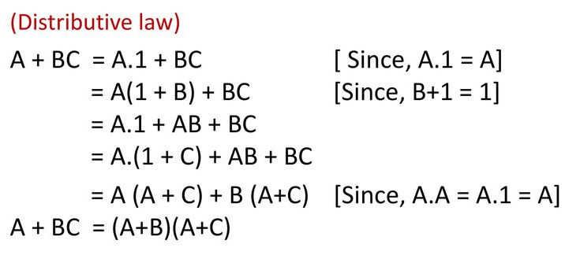

Slide 10
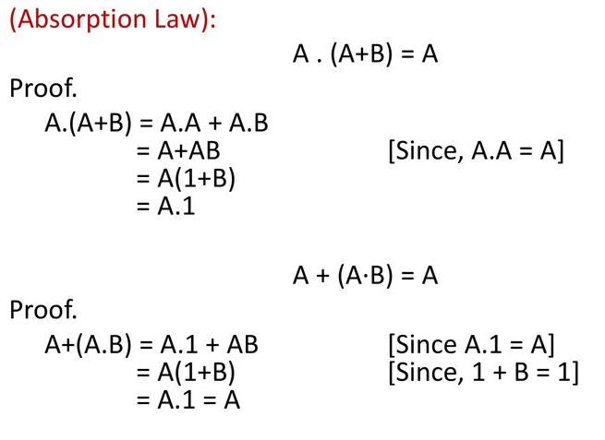

Slide 11
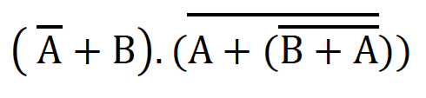
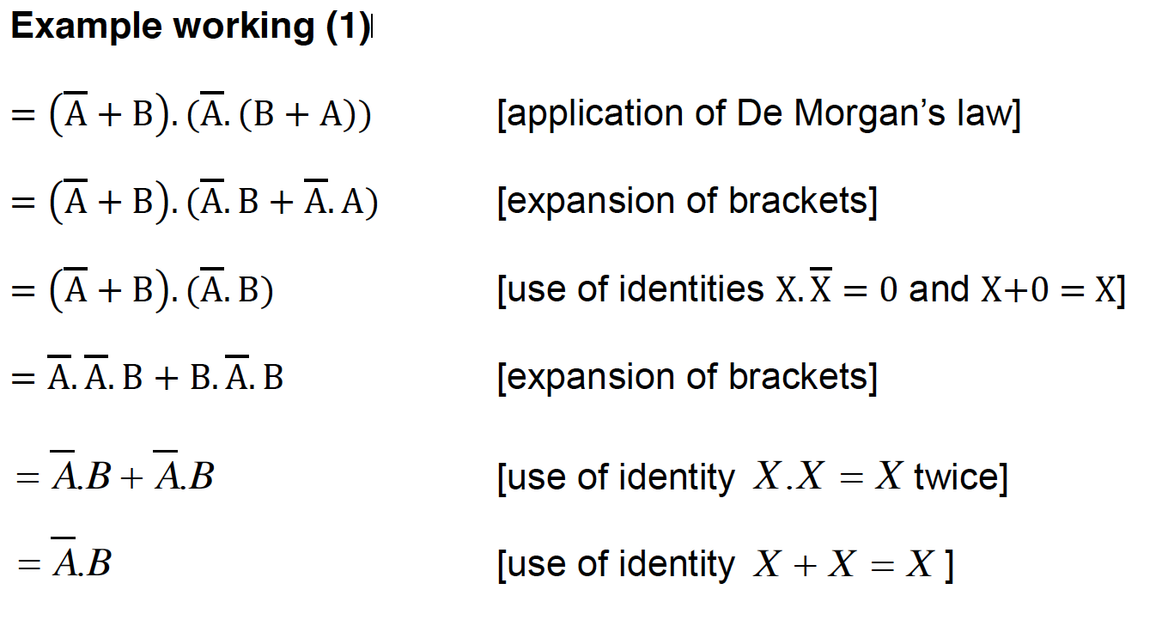

Slide 12
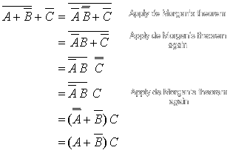

Slide 13
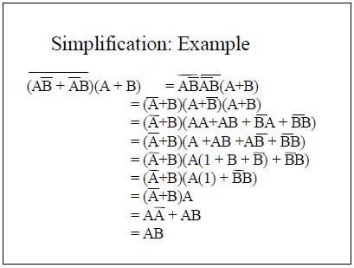

Slide 14

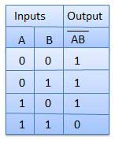
Universal Gates
NAND Gate
Logic diagram
Logic equation Y = A . B
Truth Table

Slide 15
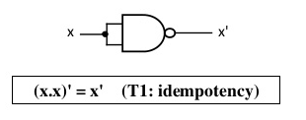
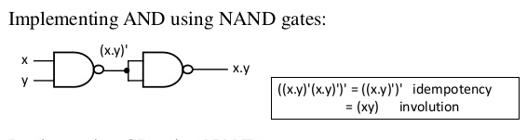
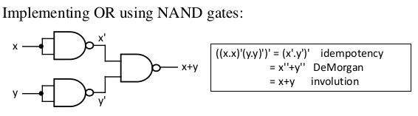

Slide 16

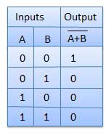
NOR Gate
Logic diagram
Logic equation Y = A + B
Truth Table

Slide 17
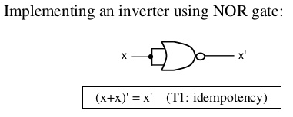
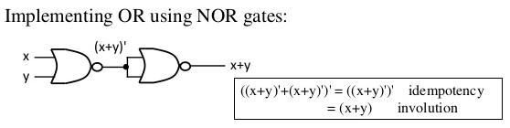
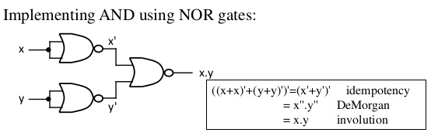

Slide 18

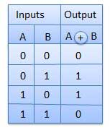
EX-OR Gate
Logic diagram
Logic equation Y = A + B
Truth Table

Slide 19

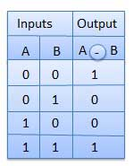
EX-NOR Gate
Logic diagram
Logic equation Y = A + B
Truth Table

Slide 20
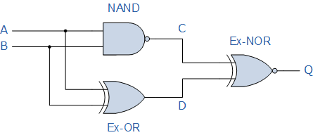
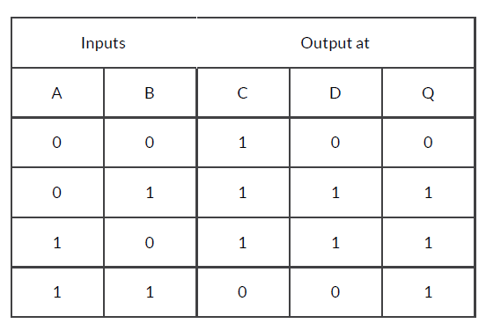
Construct a Truth Table
Q = A’B + AB’ + AB
Q = ∑ (1,2,3)

Slide 21
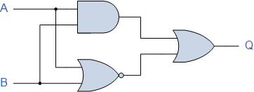
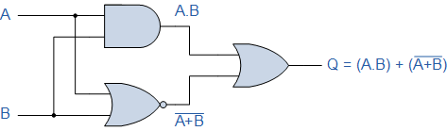
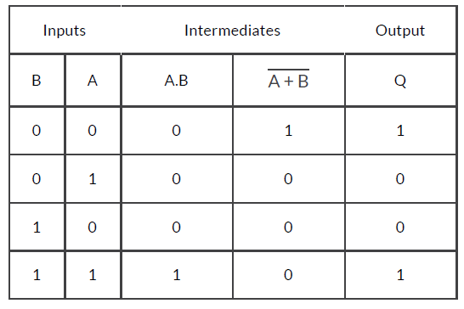
Q = A’B’ + AB
Q = ∑ (0,3)

Slide 22
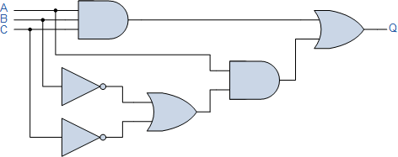
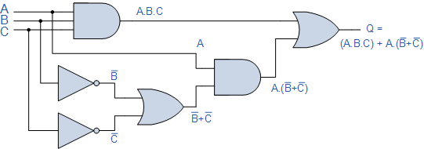

Slide 23
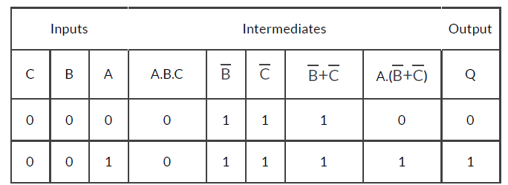
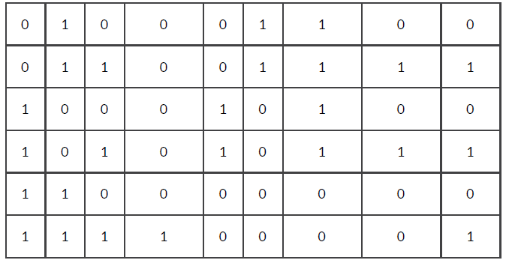
Q = AB’C’ + ABC’ + AB’C + ABC
Q = ∑ (4,5,6,7)

Slide 24

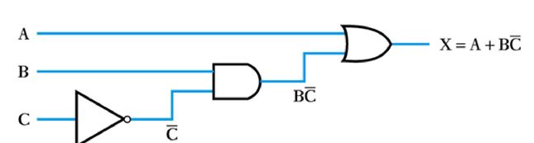
A | B | C | X
0 | 0 | 0 | 0
0 | 0 | 1 | 0
0 | 1 | 0 | 1
0 | 1 | 1 | 0
1 | 0 | 0 | 1
1 | 0 | 1 | 1
1 | 1 | 0 | 1
1 | 1 | 1 | 1
X = A’BC’ + AB’C’ + AB’C + ABC’ + ABC
X = ∑ (2,4,5,6,7)

Slide 25
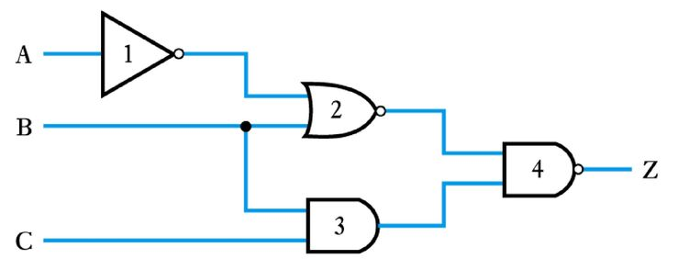

Slide 26
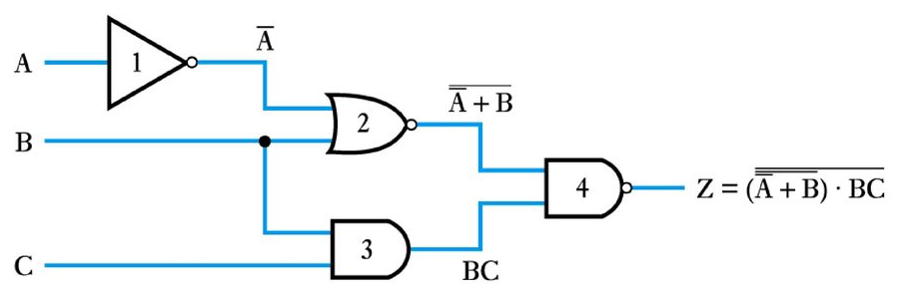
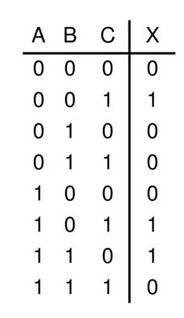

X = A’B’C + AB’C + ABC’
X = ∑ (1,5,6)

Slide 27
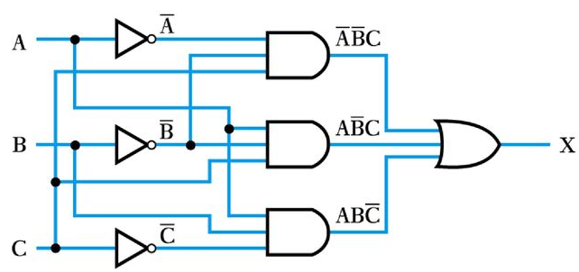


Slide 28
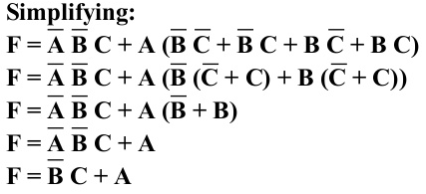

A | B | C | F
0 | 0 | 0 | 0
0 | 0 | 1 | 1
0 | 1 | 0 | 0
0 | 1 | 1 | 0
1 | 0 | 0 | 1
1 | 0 | 1 | 1
1 | 1 | 0 | 1
1 | 1 | 1 | 1
F = (A+B+C) (A+B’+C) (A+B’+C’)
F =∏ (0,2,3)

